Slide 1


1
Networking Concepts
IST-200
VWCC

Slide 2

1
Connecting computers
to form a
Local Area Network
( LAN )

Slide 3

1
Sharing of:
Hardware
Software
Information

Slide 4

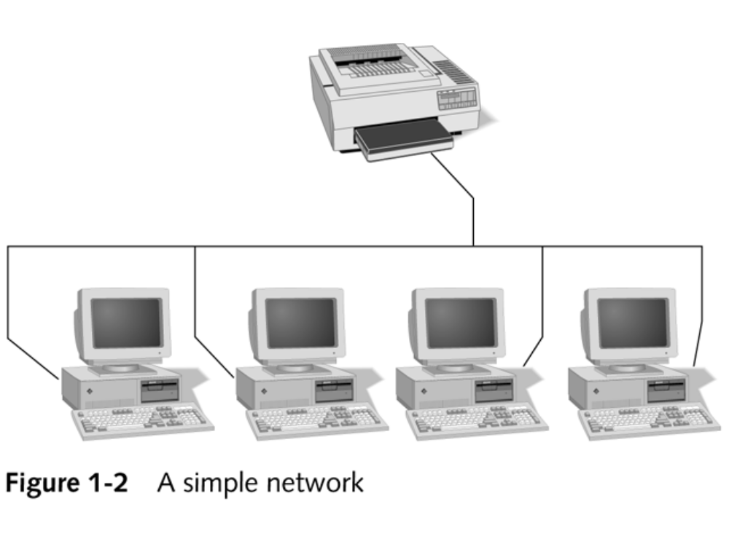
1

Slide 5

1
Early networks were custom built
Connecting a dozen computers
Only 1 or 2 peripherals
Early Ethernet
  30 users
  total span of 601 feet

Slide 6

1
A single collection of machines & peripherals
Generally less than 1000 computers
“Spanned” generally less than 250 meters feet
Basic building block for larger networks-Internetworks

Slide 7

1
A network of networks
A networked collection of LANs
More than one floor in a business (intranetwork)
Multiple buildings
Campus environment

Slide 8
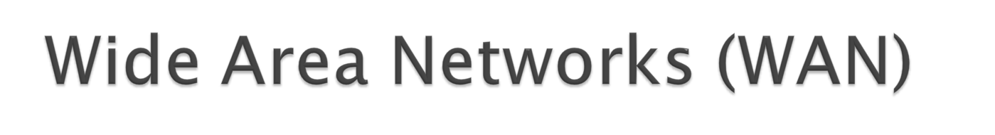
1
Spans miles of distance
Two or more separate locations
Down the road or across the world
Microsoft, Federal Express

Slide 9


1
A WAN internetwork
Millions of machines worldwide
The World Wide Web (WWW)

Slide 10

1
Client/Server relationship
Client requests shared resources
Server responds & shares resources

Slide 11
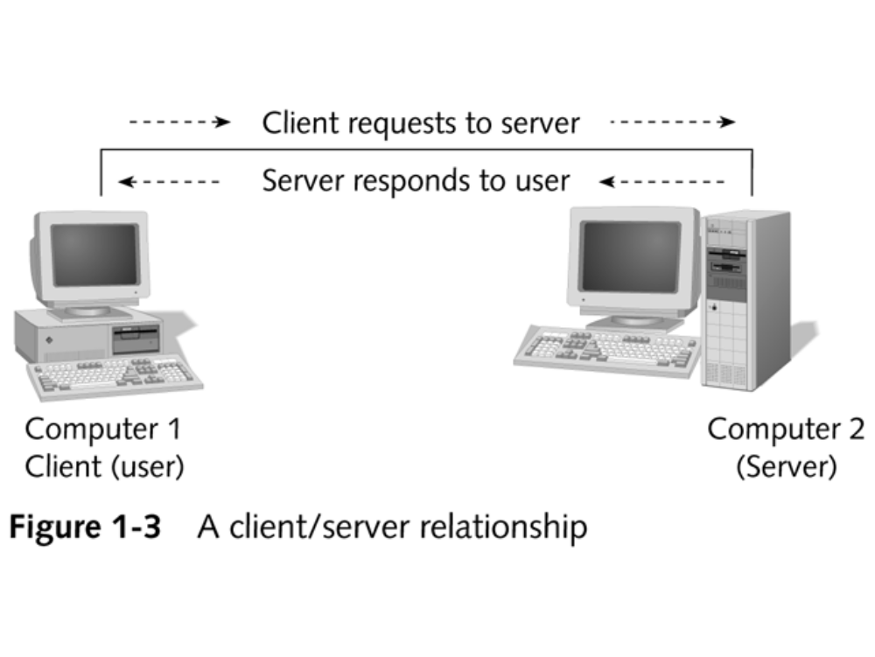
1

Slide 12
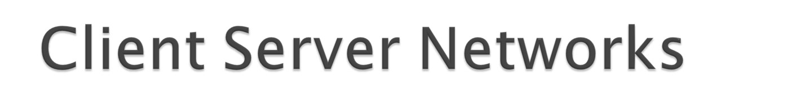
1
Concentrate CPU power & storage capacity
Windows NT Server / Server 2000
Peer to Peer
  Client/Server role interchanges
  Windows 95/98/2000/XP

Slide 13
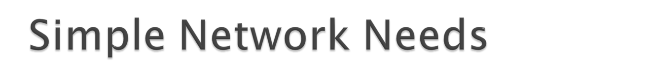
Medium to carry data
Adapter (NIC)
Protocol
Client / Server Software

Slide 14
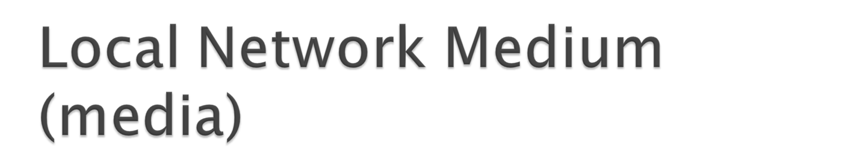
1
Carries network messages
Connects machines together on network
3 types:
  Wired
  Fiber optic cable
  Wireless

Slide 15

1
(NIC)
Physical link between machine & network
Connection between machine & medium
Also known as network adapter

Slide 16

1
Common set of communication rules
Identify ‘oneself” & others on network
Interpret signals
Begin & end network communication
Manage network information exchange

Slide 17

1
TCP/IP
  for the Internet
IPX/SPX & NWLINK
  for Novell
NetBEUI
  for Microsoft

Slide 18

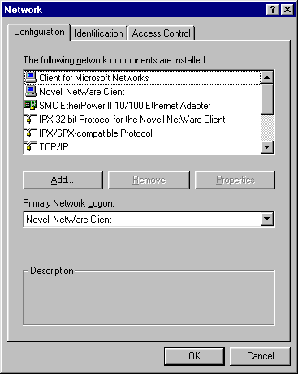
Control Panel
Networking
Protocols
Clients
Adapters

Slide 19

1
Programs that access the network
Network Operating System (NOS)
  Windows NT
  Novell NetWare (IntranetWare)
Consist of client & server components

Slide 20

1
Network Applications ( NOS & client)
Instruct network medium
Using machines interface (NIC)
Address & exchange information
To other machines on LAN or WAN

Slide 21

1
Peer to Peer
  Windows 98/2000
  Windows for Workgroups
Client Server (server-based)
  Windows NT
  Novell
  Unix / Linux

Slide 22

1
No centralized control
Act as both client & server
User controls access to machine
Institutionalized chaos & security concerns
Adding machines slows network down

Slide 23

1
Easy to install & configure
Users control individual shared resources
Inexpensive to purchase & operate
No Network Administrator
Best for 10 or fewer users

Slide 24

1
Security for only a single resource at a time
Users may need to know many passwords
Individual machine backups
Speed decreases while sharing
No central location/access of data

Slide 25

1
Server is the key to this type
Centralized control of resources
Utilize faster processors
More memory
Extra peripherals

Slide 26

1
Physical access to the server
Specialized sentry servers
Domain model
Account names
Passwords
Firewalls

Slide 27
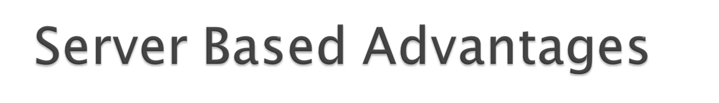
1
Central security/ accounts/ access
Simplify network administration
Powerful/ efficient access to resources
Single password for each user
Best for high use, user, networks

Slide 28

1
Server failure results in unusable network
Server failure results in loss of resources
Expert staff to manage increases cost
Dedicated hardware increases cost
Dedicated software increases cost
All disadvantages may be overcome with $$$

Slide 29

1
Individual services supplied
  Application Servers
  Communication Servers
  Domain Controllers/Directory Servers
  Fax Servers

Slide 30

1
  Mail Servers
  Web Servers
  File & Print Servers

Slide 31

1
Budget considerations, number of users?
Physical span of the network?
Specialized servers, services desired?
Internetwork or WAN access?
Future growth?

Slide 32

1
Basic elements to build a network
  Medium, physical interface, protocol
  Networking software-client & server
Basic network types
  Peer to Peer
  Server based

